Slide 1



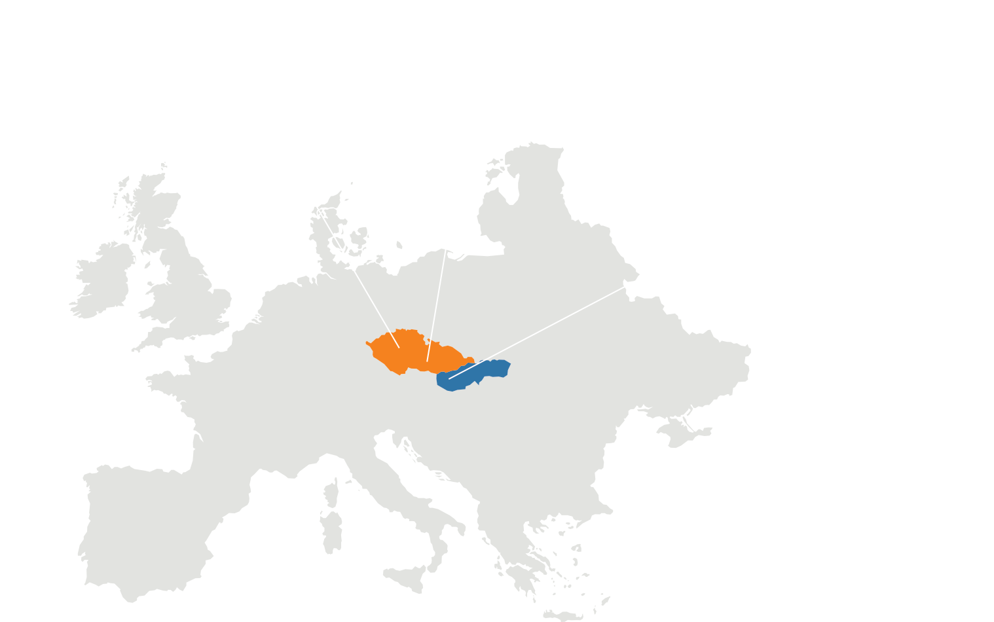




ERP
CRM
BI
Part 3 – What we learnt with AL Development
DMS
Christiaan Versfeld & Tiffany Elias
Software Developers
05. 05. 2025
AI
34
37

Slide 2
ERP
Table of Contents
Part 1 – Theoretical Fundamentals (Tiffany)
What is AL & its purpose?
Objects in AL
Development Lifecycle in AL
Testing in AL (Basics)
AL Compared to other languages
Part 2 – Practical Fundamentals (Christiaan)
System background
Core system features & Functions
Codeunits and logic
Demo
Challenges & Lessons
Part 3 – Wrap-Up and future Ideas (Both)
Expansion plans (if continued)
Challenges we faced during project cycle
What we learnt with AL Development
Q&A’s
CRM
BI
DMS
AI
34
37

Slide 3
ERP
CRM
BI
Part 1 – What is AL & its purpose?
DMS
Tiffany Elias
Software Developer
05. 05. 2025
AI
34
37

Slide 4
ERP
CRM
BI
Part 1 – Objects in AL
DMS
Tiffany Elias
Software Developer
05. 05. 2025
AI
34
37

Slide 5
ERP
CRM
BI
Part 1 – Development Lifecycle in AL
DMS
Tiffany Elias
Software Developer
05. 05. 2025
AI
34
37

Slide 6
ERP
CRM
BI
Part 1 – Testing in AL (Basics)
DMS
Tiffany Elias
Software Developer
05. 05. 2025
AI
34
37

Slide 7
ERP
CRM
BI
Part 1 – AL Compared to other languages
DMS
Tiffany Elias
Software Developer
05. 05. 2025
AI
34
37

Slide 8
ERP
CRM
BI
Part 2 – System Background
DMS
Christiaan Versfeld
Software Developer
05. 05. 2025
AI
34
37

Slide 9
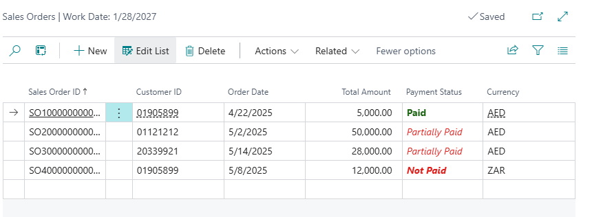
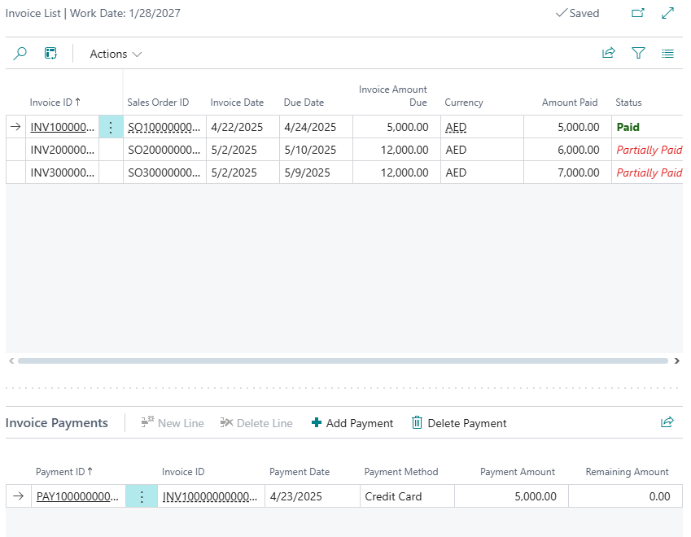
System Purpose
ERP
The purpose of the system is to provide a loyalty level to a customer based of the paid sales orders they have.
This is done by verifying the invoices that are assigned to a sales order is fully paid.
If an invoice is retracted the system will revert the paid status of the sales order thus
CRM
BI
DMS
AI
34
37

Slide 10
System Architect
ERP
Before coding or tackling any issue at hand, the first thing that must be done according to any SDLC (Software Development Life Cycle) Methodology is to Plan/Understand the problem.
CRM
BI
DMS
AI
34
37

Slide 11
ERP
CRM
BI
Part 2 – Core system features & Functions
DMS
Christiaan Versfeld
Software Developer
05. 05. 2025
AI
34
37

Slide 12
ERP
CRM
BI
Part 2 – Codeunits and logic
DMS
Christiaan Versfeld
Software Developer
05. 05. 2025
AI
34
37

Slide 13
ERP
CRM
BI
Part 2 – Challenges & Lessons
DMS
Christiaan Versfeld
Software Developer
05. 05. 2025
AI
34
37

Slide 14
ERP
CRM
BI
Part 3 – Expansion plans (if continued)
DMS
Christiaan Versfeld & Tiffany Elias
Software Developers
05. 05. 2025
AI
34
37

Slide 15
ERP
CRM
Part 3 – Challenges we faced during project cycle
BI
DMS
Christiaan Versfeld & Tiffany Elias
Software Developers
05. 05. 2025
AI
34
37

Slide 16
ERP
CRM
Part 3 – Challenges we faced during project cycle
BI
DMS
Christiaan Versfeld & Tiffany Elias
Software Developers
05. 05. 2025
AI
34
37

Slide 17
ERP
CRM
BI
Part 3 – Q&A’s
DMS
Christiaan Versfeld & Tiffany Elias
Software Developers
05. 05. 2025
AI
34
37

Slide 18


